Slide 1
DESIGN AND IMPLEMENTATION OF AN AR/VR ENVIRONMENT
FOR TEACHERS AND STUDENTS TO MEET FOR ONLINE CLASSES
Internship Project Presentation
Presented by: NFOTA LEROY-FRED EWONJUG
Matricule: 25F976
Department: Computer Engineering — Software Engineering
New Generation Technologies | June 1 – August 30, 2026
Academic Year: 2026/2027

Slide 2
Presentation Overview
• Internship context and project background
• Problem statement, aim and objectives
• System analysis and architecture
• Technologies and implementation
• Testing, results and limitations
• Conclusion and future improvements
NFOTA LEROY-FRED EWONJUG • Software Engineering • 2026/2027 2

Slide 3
Internship Context
• Host organization: New Generation Technologies
• Programme: Computer Engineering — Software Engineering
• Internship period: June 1 to August 30, 2026
• Focus: practical software engineering and web application development
• Experience covered the software development life cycle
NFOTA LEROY-FRED EWONJUG • Software Engineering • 2026/2027 3

Slide 4
Project Background
• Online learning has expanded remote teacher–student interaction
• Conventional platforms rely mainly on video, audio, chat and documents
• These approaches can provide limited immersion and social presence
• The project explores a foundation that can later be extended toward AR/VR learning
NFOTA LEROY-FRED EWONJUG • Software Engineering • 2026/2027 4

Slide 5
Problem Statement
• Limited classroom immersion in conventional online learning
• Reduced sense of social presence and interaction
• Limited interaction with three-dimensional learning resources
• Fragmentation between classroom management and communication tools
• Need for a structured platform that can evolve toward immersive learning
NFOTA LEROY-FRED EWONJUG • Software Engineering • 2026/2027 5

Slide 6
Aim of the Project
• Design and implement a virtual classroom environment for teachers and students
• Enable users to authenticate and access classroom information
• Support room management and scheduling
• Provide browser-based real-time audio/video communication
• Create a foundation for future immersive AR/VR features
NFOTA LEROY-FRED EWONJUG • Software Engineering • 2026/2027 6

Slide 7
Specific Objectives
• Analyze limitations of conventional online learning environments
• Design a user-friendly online classroom platform
• Develop registration and login functionality
• Provide teacher-oriented classroom management
• Implement password hashing and JWT authentication
• Provide browser-based real-time audio/video communication
• Test, debug and document the system
NFOTA LEROY-FRED EWONJUG • Software Engineering • 2026/2027 7

Slide 8
Significance of the Project
• Students: structured environment for online learning
• Teachers: classroom, room and schedule management
• Institutions: demonstration of emerging educational technologies
• Software engineering: integration of frontend, backend, authentication, networking and testing
NFOTA LEROY-FRED EWONJUG • Software Engineering • 2026/2027 8

Slide 9
Project Scope
• Authentication and user access
• Teacher dashboard and classroom functions
• Rooms and schedules
• Activities and internship check-ins
• Backend operational monitoring
• Browser audio/video communication
• A complete immersive 3D WebXR classroom is outside the current implementation
NFOTA LEROY-FRED EWONJUG • Software Engineering • 2026/2027 9

Slide 10
Project Limitations
• Operational data is stored in memory
• Internet connectivity is required
• Browser camera/microphone permissions are required
• Reliable production calls may require TURN infrastructure
• A completed immersive WebXR layer is not yet implemented
• The current system is best presented as a web-based virtual classroom prototype
NFOTA LEROY-FRED EWONJUG • Software Engineering • 2026/2027 10

Slide 11
Development Methodology
• Requirements analysis
• Source-code and repository review
• Interface design
• Backend/API implementation
• Frontend–backend integration
• Testing and debugging
• Documentation and evaluation
NFOTA LEROY-FRED EWONJUG • Software Engineering • 2026/2027 11

Slide 12
System Users
• Teacher — register/login, dashboard, create and manage rooms, enter live sessions
• Student/Participant — join a classroom and communicate through audio/video
• Operator/Administrator — monitor rooms and operational records
NFOTA LEROY-FRED EWONJUG • Software Engineering • 2026/2027 12

Slide 13
Functional Requirements
• Register users
• Authenticate users
• Retrieve authenticated identity
• Display dashboard
• Create and list rooms
• Display schedules and activities
• Record check-ins
• Exchange WebRTC signaling
• Control microphone and camera
NFOTA LEROY-FRED EWONJUG • Software Engineering • 2026/2027 13

Slide 14
Non-Functional Requirements
• Usability
• Security
• Reliability
• Maintainability
• Responsiveness
• Performance
• Scalability
NFOTA LEROY-FRED EWONJUG • Software Engineering • 2026/2027 14

Slide 15
System Architecture
Browser UI
HTML / CSS / JS
Node.js Server
APIs + Signaling
Peer-to-Peer Media
• Frontend manages user interaction
• Node.js provides APIs, authentication and signaling
• WebRTC carries browser media between peers
NFOTA LEROY-FRED EWONJUG • Software Engineering • 2026/2027 15

Slide 16
System Workflow
Open app
Login / Register
JWT
Dashboard
Room
Media permission
WebRTC signaling
Live class
NFOTA LEROY-FRED EWONJUG • Software Engineering • 2026/2027 16

Slide 17
Technology Stack
Core
Supporting
• Frontend: HTML5, CSS3, JavaScript
• Backend: Node.js and HTTP server
• Authentication: bcryptjs + JSON Web Tokens
• Real-time communication: WebRTC
• Package management: NPM
• Testing: Node.js test runner
• Version control/documentation: Git/GitHub and README
NFOTA LEROY-FRED EWONJUG • Software Engineering • 2026/2027 17

Slide 18
Project Structure
Core
Supporting
• package.json / package-lock.json
• README.md
• frontend/login.html
• frontend/script.js and style.css
• frontend/call.html, call.js and call.css
• backend/server.js
• backend/backend.html, backend.js and backend.css
• backend/auth.test.js
NFOTA LEROY-FRED EWONJUG • Software Engineering • 2026/2027 18

Slide 19

Authentication Module
• Login interface accepts email and password
• Registration collects user details and password
• Passwords are hashed with bcryptjs
• JWT is issued after successful login
• Protected API routes verify bearer tokens
• Password-reset tokens are designed to expire
NFOTA LEROY-FRED EWONJUG • Software Engineering • 2026/2027 19

Slide 20
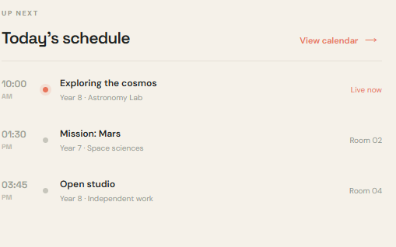
Teacher Dashboard
• Live-room information
• Room statistics
• Schedules
• Recent activities
• Room creation controls
• Central workspace for classroom management
NFOTA LEROY-FRED EWONJUG • Software Engineering • 2026/2027 20

Slide 21
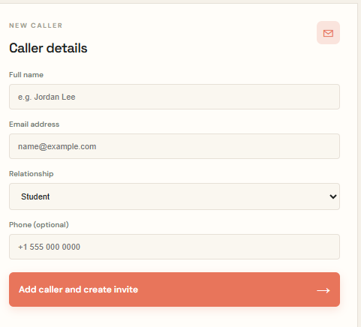
Room Management
• Rooms can be listed through the room API
• Teachers can create rooms
• Room creation uses fields such as title, year and subject
• Rooms provide the entry point for live communication
• The architecture can later support persistent class membership
NFOTA LEROY-FRED EWONJUG • Software Engineering • 2026/2027 21

Slide 22
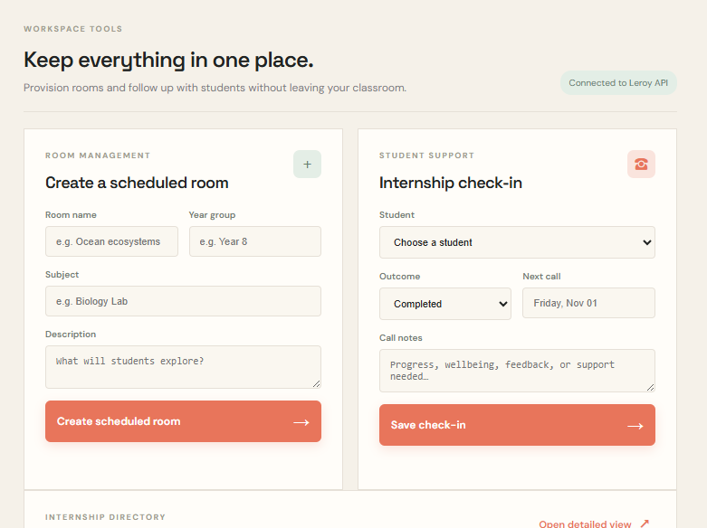
Virtual Call Room
• Uses browser media APIs
• RTCPeerConnection supports peer communication
• Microphone and camera can be enabled or disabled
• Backend endpoints support signaling
• Browser permissions are required for media access
NFOTA LEROY-FRED EWONJUG • Software Engineering • 2026/2027 22

Slide 23
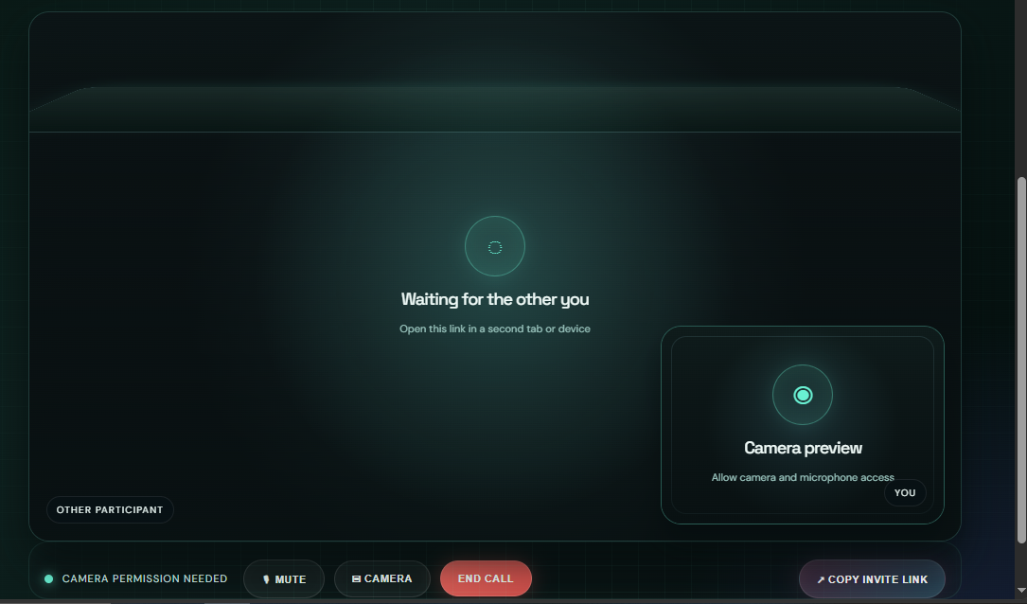
Backend Console
• Operational monitoring interface
• Supports backend/room-related visibility
• Connected to Node.js server functionality
• Useful for administration and troubleshooting
• Demonstrates separation between user-facing UI and operational functions
NFOTA LEROY-FRED EWONJUG • Software Engineering • 2026/2027 23

Slide 24
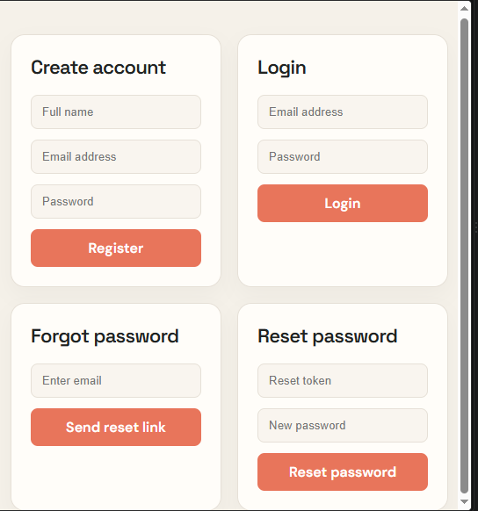
API and Client–Server Communication
• Frontend JavaScript sends requests to Node.js endpoints
• Authentication requests establish user identity
• Protected requests carry bearer JWT tokens
• Room and dashboard data are returned through APIs
• WebRTC signaling messages pass through server endpoints
NFOTA LEROY-FRED EWONJUG • Software Engineering • 2026/2027 24

Slide 25
Security Design
• bcryptjs password hashing
• JWT verification
• Bearer-token protected routes
• Expiring reset tokens
• Environment-managed authentication secret
• HTTPS recommended for production deployment
NFOTA LEROY-FRED EWONJUG • Software Engineering • 2026/2027 25

Slide 26
Testing Strategy
• Authentication and protected endpoints
• API behavior
• Registration and login
• Room creation
• WebRTC workflow
• Automated authentication tests
• Functional verification and debugging
NFOTA LEROY-FRED EWONJUG • Software Engineering • 2026/2027 26

Slide 27
Testing Results
• Unauthenticated /api/auth/me → 401 Unauthorized — Passed
• Valid token /api/auth/me → 200 + user identity — Passed
• Unauthenticated /api/dashboard → 401 Unauthorized — Passed
• Valid registration → account created — Implemented
• Valid login → JWT returned — Implemented
• Valid room creation → room created — Implemented
• Automated suite: 3 passes, 0 failures
AUTOMATED TESTS: 3 PASSES • 0 FAILURES
NFOTA LEROY-FRED EWONJUG • Software Engineering • 2026/2027 27

Slide 28
Challenges and Solutions
• Challenge: frontend/backend interaction → solved through API inspection and incremental testing
• Challenge: authentication state → verified JWT flow and protected endpoints
• Challenge: WebRTC signaling → tested peer-connection workflow
• Challenge: browser media permissions → handled through browser permission controls
• Challenge: integration issues → debugging and step-by-step verification
NFOTA LEROY-FRED EWONJUG • Software Engineering • 2026/2027 28

Slide 29
Results and Evaluation
• Functional web-based virtual classroom foundation achieved
• Authentication and teacher workspace are integrated
• Room management is implemented
• WebRTC signaling supports browser communication
• Architecture is coherent and expandable
• Main gaps are persistent storage and full immersive WebXR implementation
NFOTA LEROY-FRED EWONJUG • Software Engineering • 2026/2027 29

Slide 30
Conclusion and Future Work
• The internship strengthened practical software engineering skills
• The project demonstrates a functional virtual classroom prototype
• Future versions should add MySQL/PostgreSQL persistence
• Add dedicated student dashboards, attendance and class membership
• Add chat, file sharing, assignments and notifications
• Configure TURN and HTTPS for reliable production use
• Develop 3D WebXR classrooms, avatars, spatial audio and virtual laboratories
NFOTA LEROY-FRED EWONJUG • Software Engineering • 2026/2027 30

